Slide 1
JSPM’S
BHIVARABAI SAWANT INSTITUTE OF TECHNOLOGY AND RESEARCH, WAGHOLI
Unit 3: Software Test Automation
Prof. Adsure Sharad S.

Slide 2
VISION MISSION
Institute Vision
"Satisfy the aspirations of youth force, who want to lead nation towards prosperity through techno-economic development."
Institute Mission
To provide, nurture and maintain an environment of high academic excellence, research & entrepreneurship for all aspiring students, which will prepare them to face global challenges maintaining high ethical and moral standards."
Department Vision
Empowering the students to be professionally competent & socially responsible for techno-economic development of society.
Department Mission
To provide quality education enabling students for higher studies, research & entrepreneurship
To inculcate professionalism and ethical values through day to day practices.

Slide 3
CONTENTS
Introduction to Automated Software Testing
Process of Automated Testing
Advantages & Disadvantages
Choosing Automation Tools

Slide 4
INTRODUCTION TO AUTOMATED SOFTWARE TESTING
“Software Testing is usually the part of the project which makes grown men weep” [1]
Ever-shrinking schedule and minimal resources
It involves automating a manual process of testing
Notes:
organisations have turned to automated software testing
For things like code errors and verifying test requirements

Slide 5
DEFINITION OF AUTOMATION
“Automation is the use of tools and
strategies that reduce human involvement
or interaction in unskilled, repetitive or
redundant tasks” [2]

Slide 6
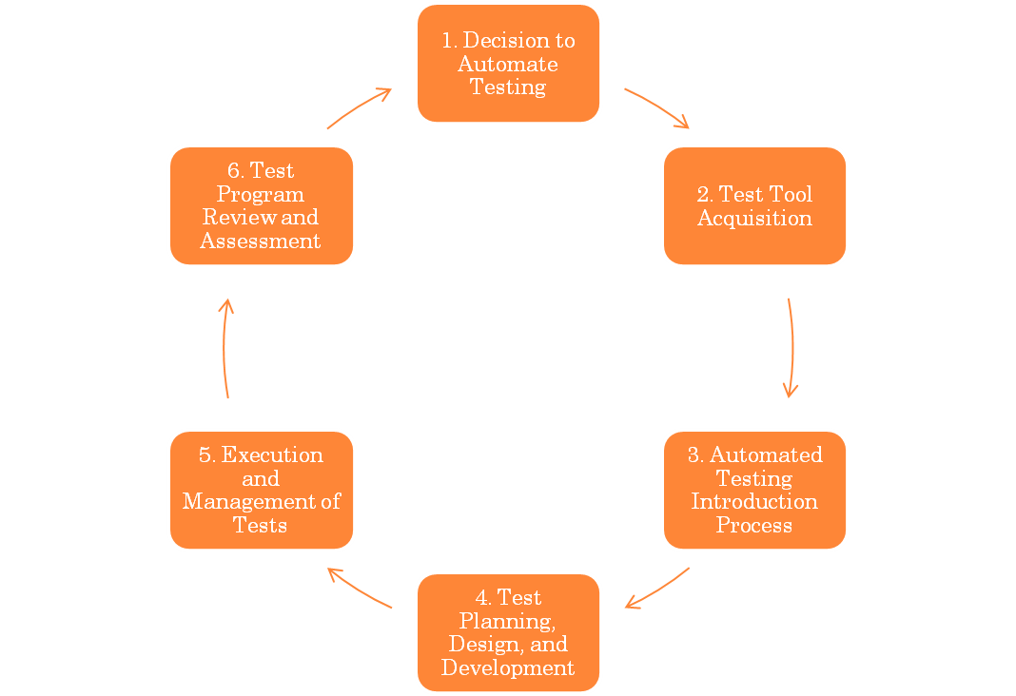
THE AUTOMATED TEST LIFECYCLE METHODOLOGY [4]
Notes:
This systematic method maximizes test coverage
outline the potential benefits and test tool proposal
test tool evaluation and selection
Steps necessary to outline automated testing to the project
Identifies the test procedure standards, defines the tests, defines development standard
Test plans are executed
This is done throughout the lifecycle

Slide 7
WHY AUTOMATE?
Verification and Validation of the requirements and organisation
Defects and Failures caused by misunderstood requirements or coding errors
Compatibility of the Software
Notes:
Verification – developed software matches the requirements
Validation – it is what the organisation wanted
Defects and failures – incorrectly setup environments or wrong version of software being deployed – human error - bug or malfunction - system malfunctioning or failing
Compatible – so that new software deployed wont mess up any existing apps

Slide 8
ADVANTAGES & DISADVANTAGES OF AUTOMATED TESTING
Advantages
Disadvantages
High investment is needed in the tools and training
High man power requirement for test preparations
A lot of testing areas left uncovered
Reliable: eliminating human error
Reusable
Better Quality Software
Fast
Cost Reduction
Notes:
Reliable: carries out the same operations - eliminating human error
Reusable: can reuse tests on different versions of an application
Better Quality Software: can run more tests in less time with fewer resources – good coverage
Fast: run tests significantly faster than human users.
Cost Reduction: number of resources for tests are reduced.
Replaces: manually mundane and labour intensive tasks

Slide 9
CHOOSING AUTOMATION TOOLS
Ease of integration
Compatibility
Performance
Types of tests
Maintainability
Affordability
Notes:
Is it easily integrated with the system? – weighed against cost and performance of the tool
Is it compatible with the design and implementation of the system?
How till it perform in the environment – e.g network traffic, hardware?
Type of tools are directly dependent
Main- how good is the support? online communi?

Slide 10
SUMMARY
Automate tests for ever-shrinking schedules and minimal resources
Automated software testing lifecycle
Advantages and disadvantages of automation
Choosing automation tools

